Slide 1


KSR EDUCATIONAL INSTITUTIONS
RFID BASED SMART ATTENDANCE SYSTEM
Block diagram:
BATTERY
ARDINO UNO
RFID READER MODULE
I2C MODULE
RFID CARD
LCD DISPLAY

Slide 2
Objectives:
Radio Frequency Identification (RFID) is a new technology in communication system which can be define as a medium used to identify and track the special tag implanted into an object or a living thing by using radio frequency wave. It is a wireless mean of communication that use electromagnetic and electrostatic coupling in radio frequency portion of the spectrum to communicate between reader and tag through a variety of modulation and encoding scheme. Nowadays, most of universities used the conventional method of taking attendance by calling names or signing on paper is very time consuming and inefficient. From that, by integrating various components which are Ardino uno,EM-18 RFID Reader Module,RFID card,LCD display,I2c display module, a portable RFID based attendance system can be set up and become the solutions to address this problem. Uniquely identify each person based on RFID tag is one of its special ability that can make the recording attendance process become more faster and easier compared to conventional method.
Components required:
Ardino uno,
EM-18 RFID Reader Module,
RFID card,
LCD display,
I2c display module.

Slide 3
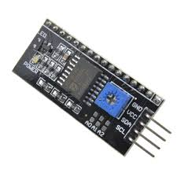
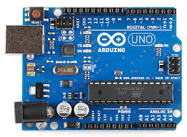
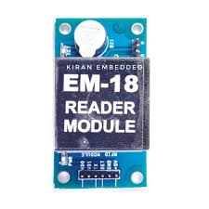
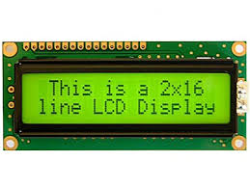
CIRCUIT DIAGRAM:

